Slide 1
Determining the locus of phonological variation in Historical Choctaw
Seth (Dani) Katenkamp, Yale University

Slide 2
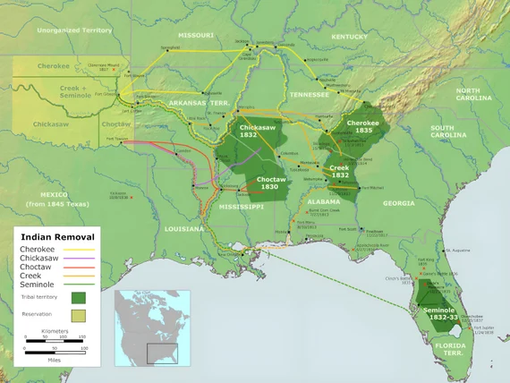
Quick geography

Slide 3
Interesting entries in Byington (1915)
What is Byington (1915)?
A Dictionary of the Choctaw Language
Created via Bible translation work by Cyrus Byington during his time among the Choctaws from 1827-1867
Assembled/edited by John Swanton (hence 1915), he appears to have consulted some speakers for additional information
Pairs of entries that seem related
Very phonologically similar, either minimal pairs or varying in similar ways to cognates between Muskogean languages (Haas, 1945)
Similar and often identical definitions

Slide 4
Examples (with modernized orthography)
 | Word 1 | Definition | Word 2 | Definition
(a) | alhpi | (1) a handle; a haft; a hilt. (q.v.) (2) a handle; a hasp. | olhpi | (1) a handle; a haft; a hilt. (q.v.) (2) a handle; a hasp.
(b) | nakshofa | singed; scorched; burnt. | nokshofa | singed; scorched; burnt.
(c) | piyaalichi | to trouble water; to make water wave or ripple, John 4:4[?]. | poyaalichi | to cause the waves to roll high or to move either in waves or with the tides; to shake water; as isht ishko oka ʋnit poalichit latʋbli, to rinse a cup.

Slide 5
More on the variation in Byington (1915)
~1000 pairs of entries like this
More than 100 different variations (e.g. /sh/~/y/, /a/~/o/, etc.)
But most are instantiated across only a few pairs, while a few appear to be recurring
31 pairs that vary only in /b/~/p/

Slide 6
What are these?
A lot of possibilities
Some are probably in free variation for all speakers
In Modern Choctaw dialects, variation between tabli ‘cut’ and tapli ‘cut’ is the result of optional voicing before the suffix -li, and most speakers produce both forms (Ulrich, 1986, Broadwell, 2006)
Some are probably dialect variants
Kalakbi ‘valley’ described in the dictionary as “a Sixtowns form” referring, to the Southern District of the homeland in Mississippi: i.e. a dialect variant

Slide 7
Investigating…
These possible loci of variation aren’t discernible from the dictionary, but we can try to identify them using corpora
For texts that have multiple tokens for the ‘word’ in question:
Variants which are produced by most/all speakers (like tabli~tapli) should rarely appear alone in a text
Variants which are dialectal should rarely appear together in a text
We can use the Historical Choctaw Corpus!

Slide 8
The Historical Choctaw Corpus
630k words of Choctaw from 19th century Choctaw Nation
2315 texts
produced by hundreds of authors
A mix of evangelical religious materials and court records/letters to county courts from 1865-1905
some of the evangelical material is Choctaw versions of English language texts, but otherwise all Native text
Most are originally written correspondences or records
But others are transcripts of spoken testimony (neat!)

Slide 9
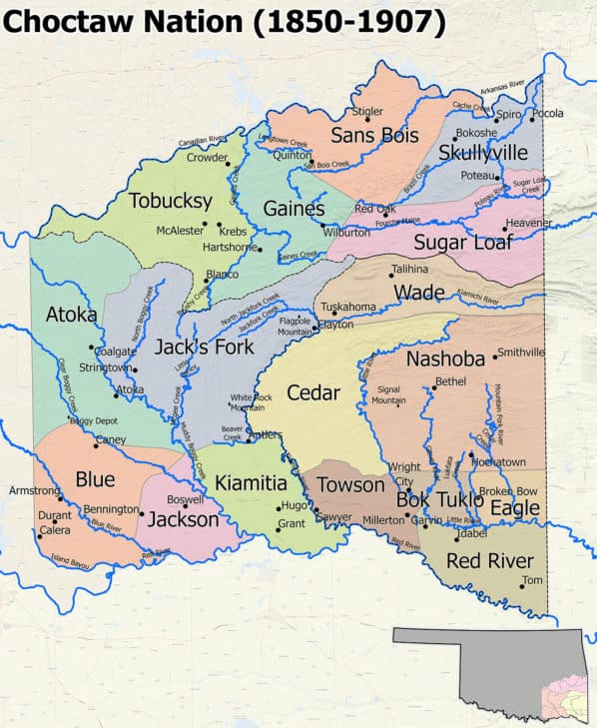
Problems
Texts are tiny
Average 273 words
Less if we take out the minute books
Routinized language
Not all fully tagged for speaker
Disproportionately from the southeastern part of the Nation
So if variation is geographically distributed (post-Removal), we might miss it

Slide 10
A typical petition: 1885 Red River County- Case No. 019 (159 words)
Anumpa yakohmi ikbit chitikba bohlilishki. Yohmi kʋt hattak hohchifo Greggs Logan illʋppʋt Bok Humma County aiyʋtta osh oka Hommi ya̱ August nitak 12th 1885 fihna Chahta yakni isht chokowat tok achi ho̱ Chahta yakni nan ʋlhpisa ittoyola tok ʋt kobakʋt a̱hli shki. Ahnit Nov 5th 1885 fihna yokachilishki. Yohmi hosh anumpa a̱hli mako̱ Koat holitopa itikba atokma bohlilishki.
Anumpa yakohmi chim alishki Hatak hohchifo Greggs Logan osh pih ilap haksi apissali hosh anonti ohoyo hohchifo Naisi Lomon ʋt i̱ choka anta tuk o̱ §Greggs Logan ʋt April nitak atuchina kosh ona cha huklit aiessa tuk achi hosh anumpa hʋt isht ai onnotoyola shki ilʋppat nan ʋlhpisa Chahta okla pitoyola micha isht itti nan aiya micha nan isht itti holo aiena ma kobaffi mak oki yamohmi hoka achikosi mak inli ont yokachit ishishi tuko̱ kʋtʋsh nan im apisa ho̱ nan ai ʋlhpisa im ʋlhpisashki = isht aia̱hla chi̱ ka̱ himak April 12th AD 1886 fihna ʋno sabbak isht ʋlhtahashki.
I submit before you the following statement. A man named Greggs Logan who lives in Bok Homma [Red River] County, is reported to have entered the Nation on 12 Aug 1885 with liquor, in violation of the laws of the Choctaw Nation. With this in mind, I arrested him on 05 Nov 1885. So I submit this truthful report to the Honorable Court.
I will tell you the following: This man named Greggs Logan got drunk and then was at the house of a woman named Naisi Lomon. Greggs Logan went on the third day of April and is accused of having attacked her. This violates the laws, traditions, and values of the Choctaw people. So I complete this [petition] with my own hand today on 12 April 1886, so that you can quickly arrest him and somebody can judge him.

Slide 11
Picking one well attested alternation: a~o
Several well-attested pairs
We’ll look at 7:
okpani okponi ‘damage’
alhtakowa alhtokowa ‘selected (pl)’
-an -on ‘interrogative’
panaklo ponaklo ‘ask’
asapa osapa ‘field’
ataklam- atoklam- ‘bother’
onattola onottola ‘accused’

Slide 12
Gathering data
Get the number of hits for each variant in each text
Until we have all (most?) authors tagged we’re using ‘text’ as proxy (since other than court minute books most authors aren’t repeat petitioners)
Texts with only one hit of a word (or zero) aren’t super insightful, so we’ll ignore those

Slide 13
Total hits for each variant
 | alhtVkowa | okpVni | pVnaklo | atVklam- | Vsapa | onVttola | -Vn
A | 5 | 170 | 1139 | 267 | 7 | 58 | 19
O | 81 | 3 | 7 | 14 | 252 | 367 | 490
Dominant? | O | A | A | A | O | O | O
Notes:
The non-dominants have fallen out of use in Modern Oklahoma Choctaw based on Choctaw Nation (2016)

Slide 14
Distribution in texts with 2+ tokens
2+ hits | alhtVkowa | okpVni | pVnaklo | atVklam- | Vsapa | onVttola | -hVn*
Hits in these texts | 1 A, 21 O | 91 A, 1 O | 6 A, 803 O | 121 A, 10 O | 7 A, 57 O | 26 A, 232 O | 14 A, 444 O
Texts with only A | 0 | 35 | 0 | 43 | 0 | 11 | 0
Texts with only O | 7 | 0 | 154 | 2 | 54 | 73 | 61
Texts with both | 1 | 1 | 3 | 5 | 3 | 2 | 10
3+ hits | okpVni | pVnaklo | atVklam- | Vsapa | onVttola | -hVn*
Hits in these texts | 47 A, 1 O | 5 A, 85 O | 52 A, 3 O | 7 A, 100 O | 35 A, 151 O | 10 A, 412 O
Texts with only A | 13 | 0 | 12 | 0 | 1 | 0
Texts with only O | 0 | 20 | 0 | 22 | 27 | 47
Texts with both | 1 | 2 | 2 | 3 | 1 | 6

Slide 15
Things to notice in these data:
One variant is significantly more common
Most speakers use only the more common/dominant variant
The less common variant is almost exclusively used in texts that also contain the more common variant
So two groups of speakers:
(a) those who use only the more common form
(b) those who use both forms
 | taBli (n>1)
hits | 19 B, 19 P
B | 7
P | 4
both | 1

Slide 16
Comparing the less common variants
Different words have different dominant vowels:
ataklam- ‘bother’ vs. onottola ‘accused’
Doesn’t seem to reflect anything phonologically consistent (such as regressive vowel assimilation)
The distribution of the less common variants do not overlap between words (e.g. between atoklam- ‘bother’ and onattola ‘accused’)
This includes looking at texts with only one token
Likely partly a result of so few tokens for many of them

Slide 17
Summary of distributional facts
/a/~/o/ variation is inter-speaker variation
Two groups of speakers for each word:
(a) those who use only the more common form
(b) those who use both forms
/a/~/o/ variation is not a coherent class because there is variation in both:
Which variant is significantly more common is not consistent (it’s not either always /a/ or always /o/
The speakers in group (b) for one word will not necessarily be in group (b) for another

Slide 18
What does this mean?
Because there isn’t clear phonological conditioning, assessing the diachrony is difficult
We can’t assume that the stems featuring other types of variation are a consistent class
Which makes them much harder to learn about because they are less well attested in the corpus

Slide 19
Conclusion: What do we do next?
Our interests now exist at the intersection of two problems:
Most of the variants in Byington (1915) aren’t well attested in corpora
The distribution of more common variants suggests that we can’t expect different variation pairs to behave similarly (i.e. we can’t generalize over rarer pairs or alternation types)
Other possible approaches?
comparative work like Haas (1945)
Trying to find individual phonological alternations in words that occur in routinized court expressions
Place names from un-digitized 1840s land claims

Slide 20
Thank you! (feedback/advice is very welcome!)

Slide 21
References
Broadwell, George Aaron. (2006). A Choctaw Reference Grammar. University of Nebraska Publishing.
Byington, Cyrus. (1915). A Dictionary of the Choctaw Language. Ed. John Swanton. Smithsonian Institute
Haas, Mary. (1945). “Dialects of the Muskogee Language.” International Journal of American Linguistics. Vol. 11:2. Pp. 69-74.
Ulrich, Charles. (1986). Choctaw Morphophonology. PhD dissertation. University of California, Los Angeles.

